Slide 1


Embassy
Recommends:
Flowering Shrubs

Slide 2
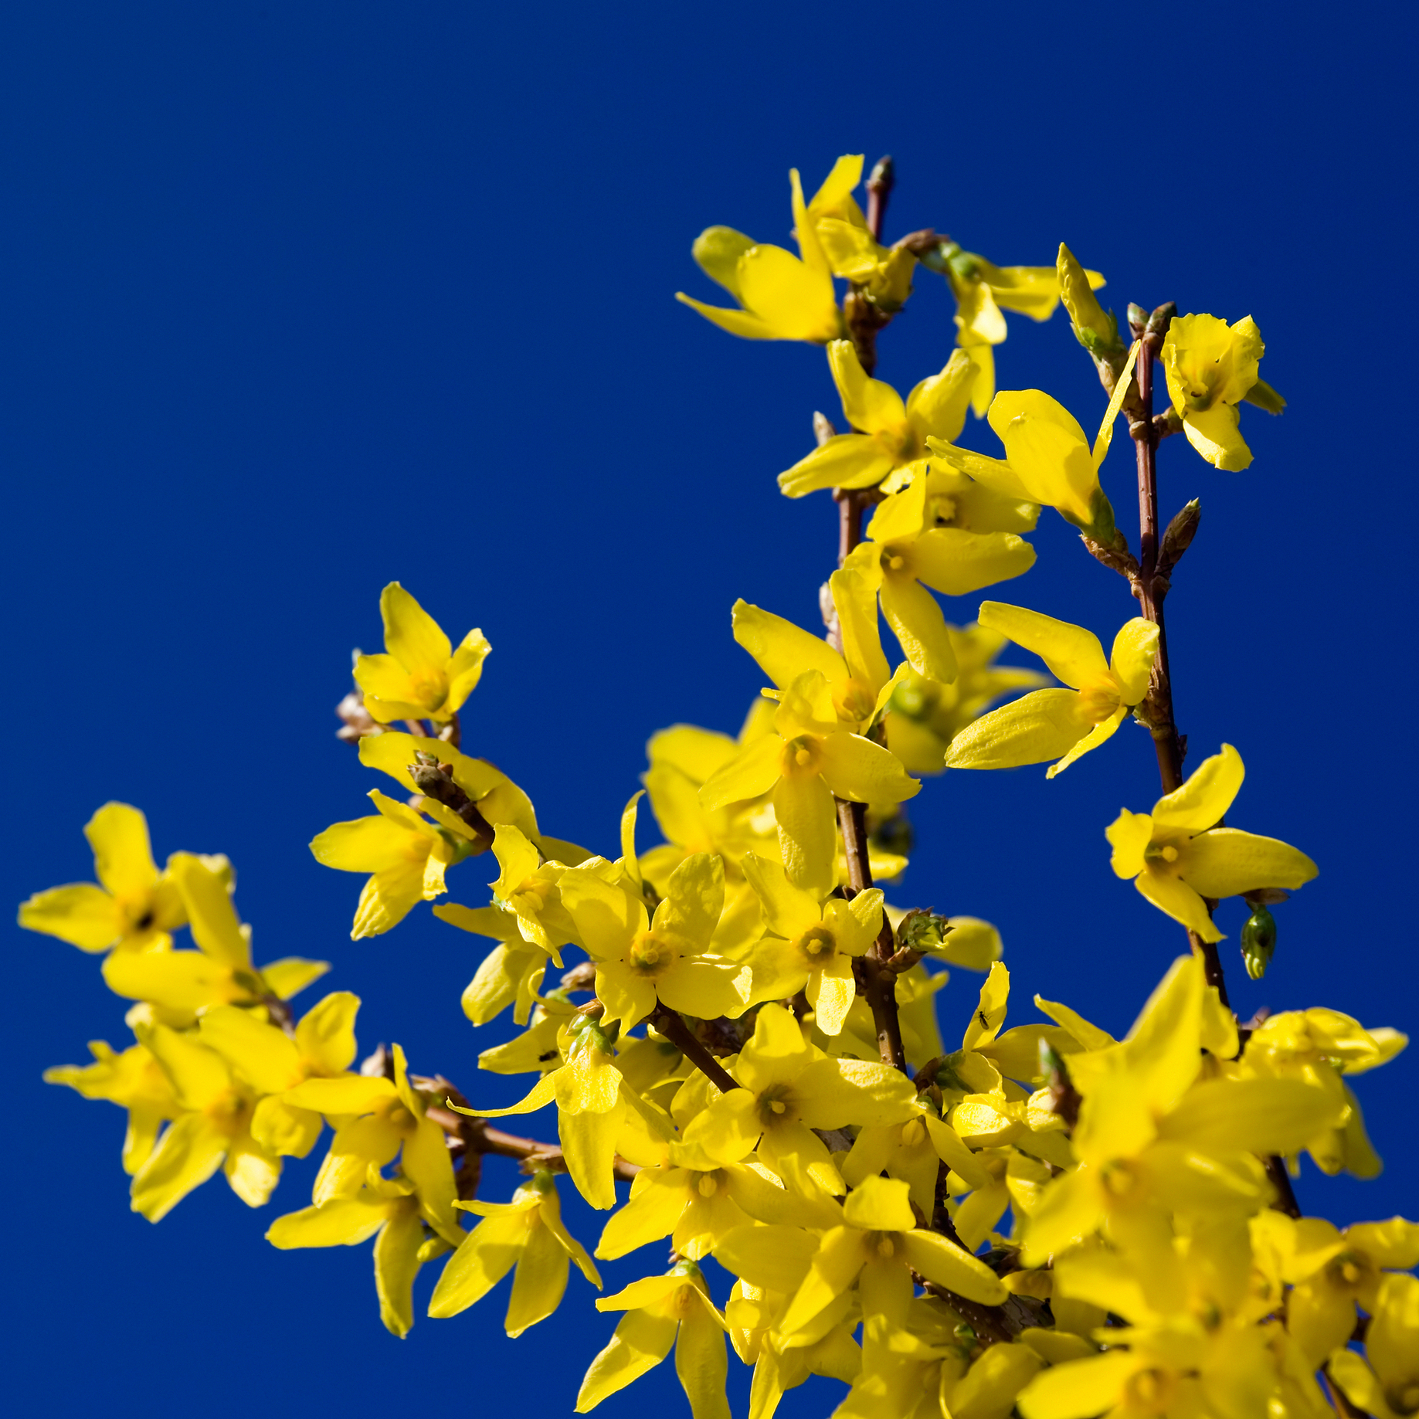

Forsythia
Native: East Asia; Europe
Zones: 5 to 8
Bloom: March to April
Color: Yellow
Height: 3 to 10 ft. (by cultivar)
Habit: Arching to spreading
Light: Full sun to med. shade
Water: Medium
Soil: Average to clay
Fall: Yellow-green to purple

Slide 3
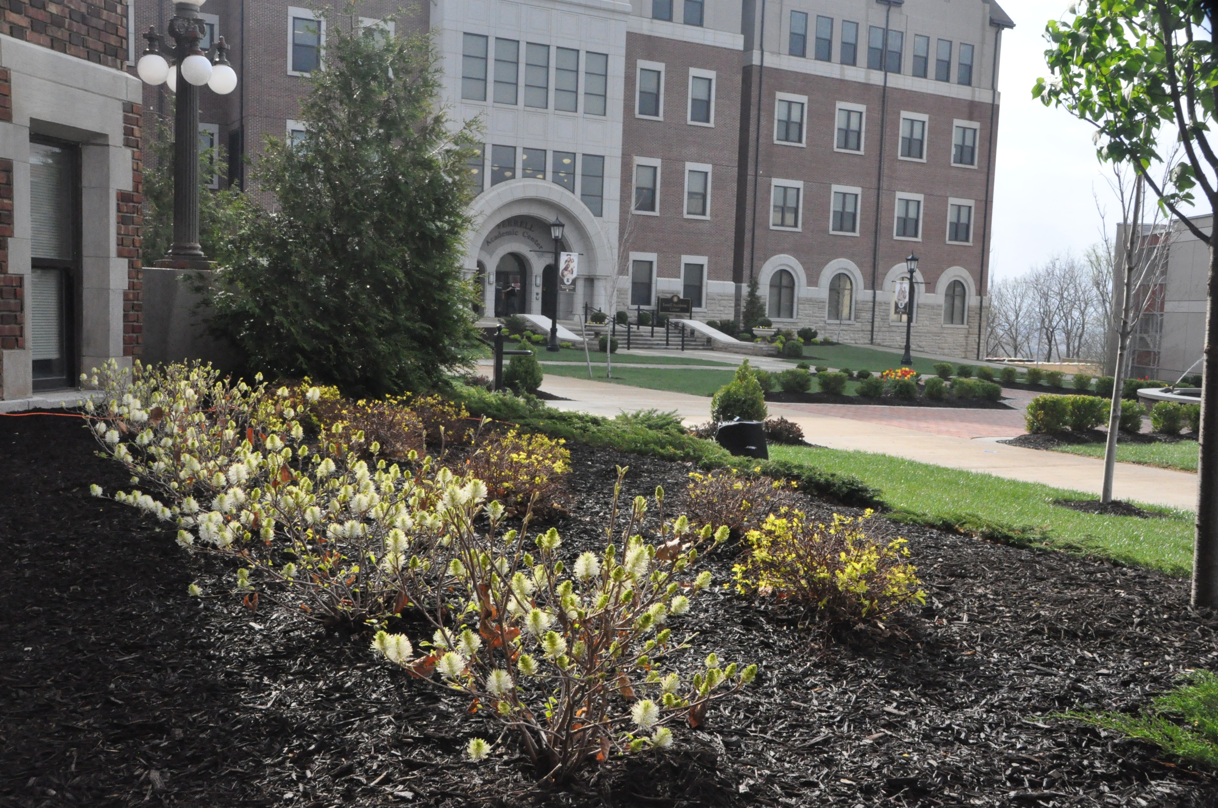
Fothergilla Fothergilla gardenii
Native: Southeastern United States
Zones: 5 to 8
Bloom: April to May
Color: White, fragrant, bottlebrush shaped
Height: 1.5 to 3 ft.
Habit: Compact, mounded
Light: Full sun to med. shade
Water: Medium
Soil: Moist
Fall: Red, orange and yellow foliage
Benedictine College photo by Sandy DeFoe, Embassy

Slide 4
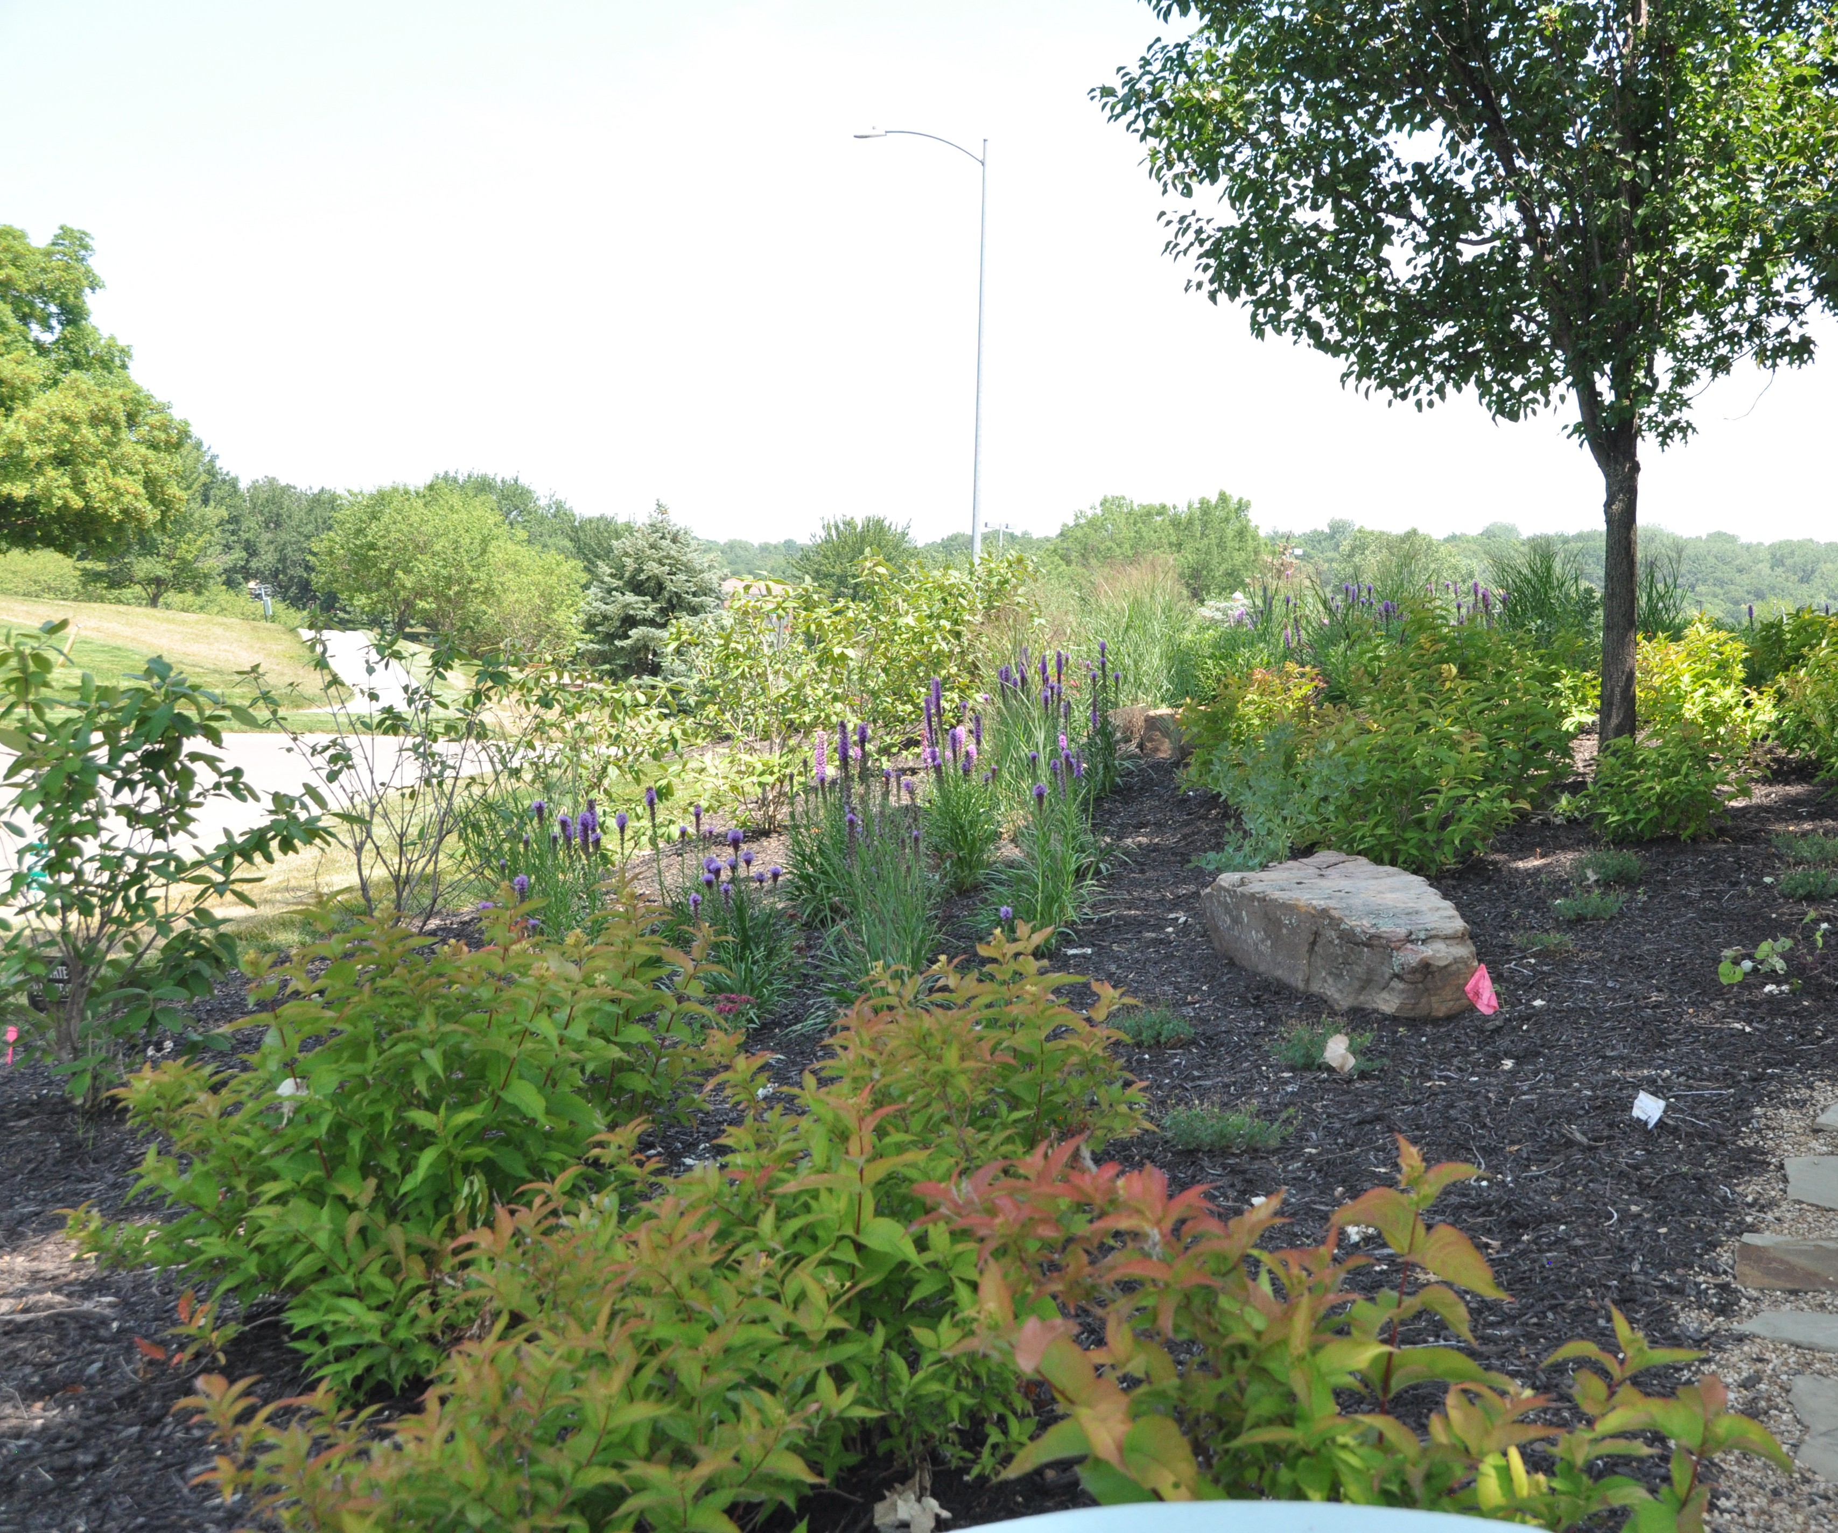
Deutzia Deutzia gracilis
Native: Japan
Zones: 5 to 8
Bloom: April to May
Color: White, fragrant star-shaped clusters
Height: 2 to 5 ft.
Light: Full sun to part shade
Habit: Dense, rounded
Water: Medium
Soil: Average, well-drained
Fall: Stays green until leaves drop
Briarcliff Residence photo by Sandy DeFoe, Embassy

Slide 5
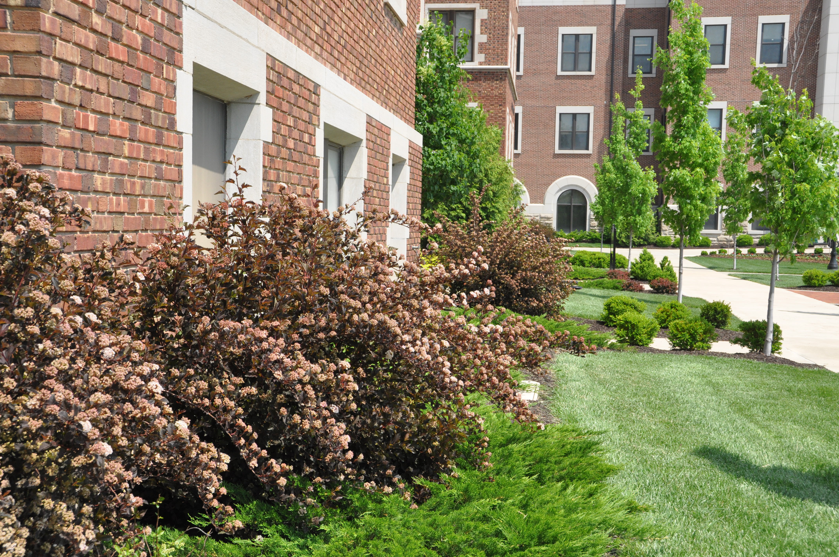
Ninebark Physocarpus opulifolius
Native: Central and eastern United States
Zones: 2 to 8
Bloom: May to June
Color: White or pink
Height: 5 to 8 ft.
Light: Full sun to part shade
Habit: Upright, spreading
Water: Dry to medium
Soil: Dry to medium, well-drained
Fall: Peeling bark reveals reddish- brown inner bark
Benedictine College photo by Sandy DeFoe, Embassy

Slide 6
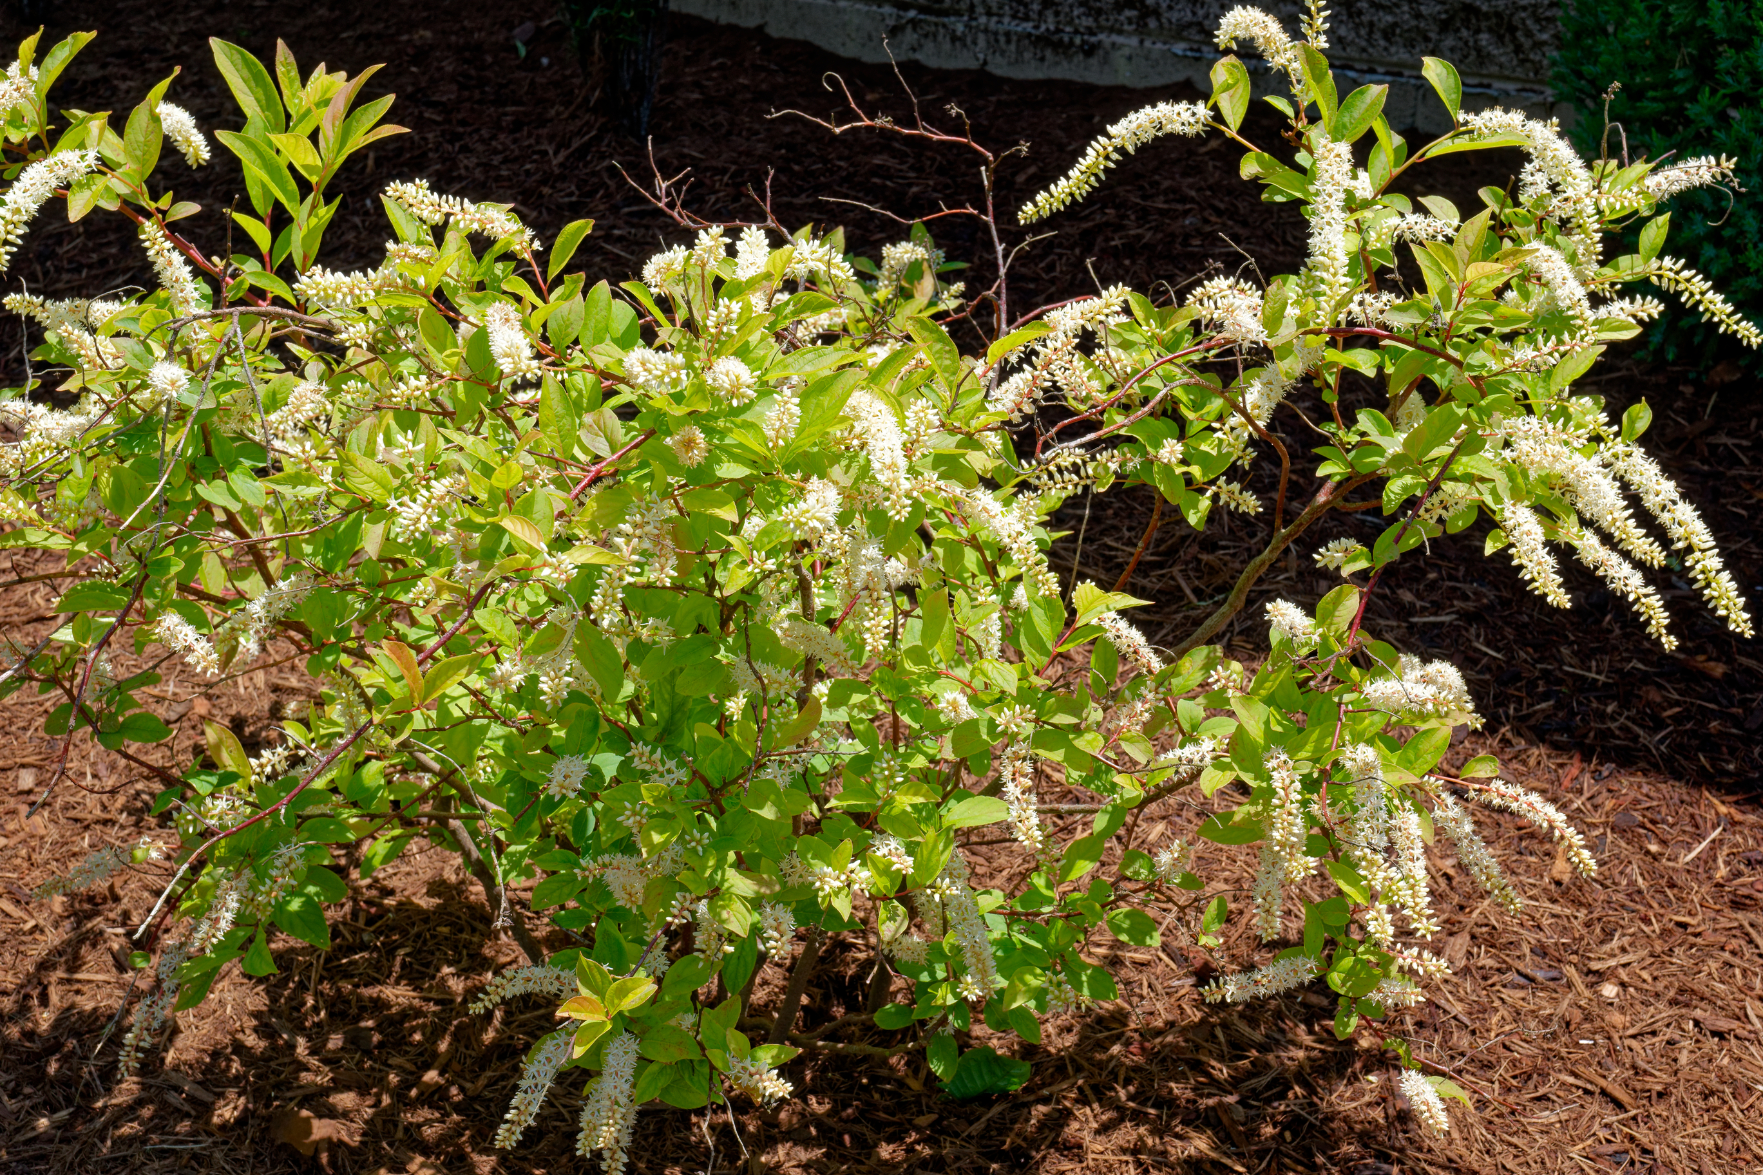
Virginia Sweetspire Itea virginica
Native: Eastern North America
Zones: 5 to 9
Bloom: June to July
Color: White, fragrant
Height: 3 to 5 ft.
Light: Full sun to part shade
Habit: Arching, rounded
Water: Medium to wet
Soil: Average, well-drained
Fall: Red, orange and gold

Slide 7
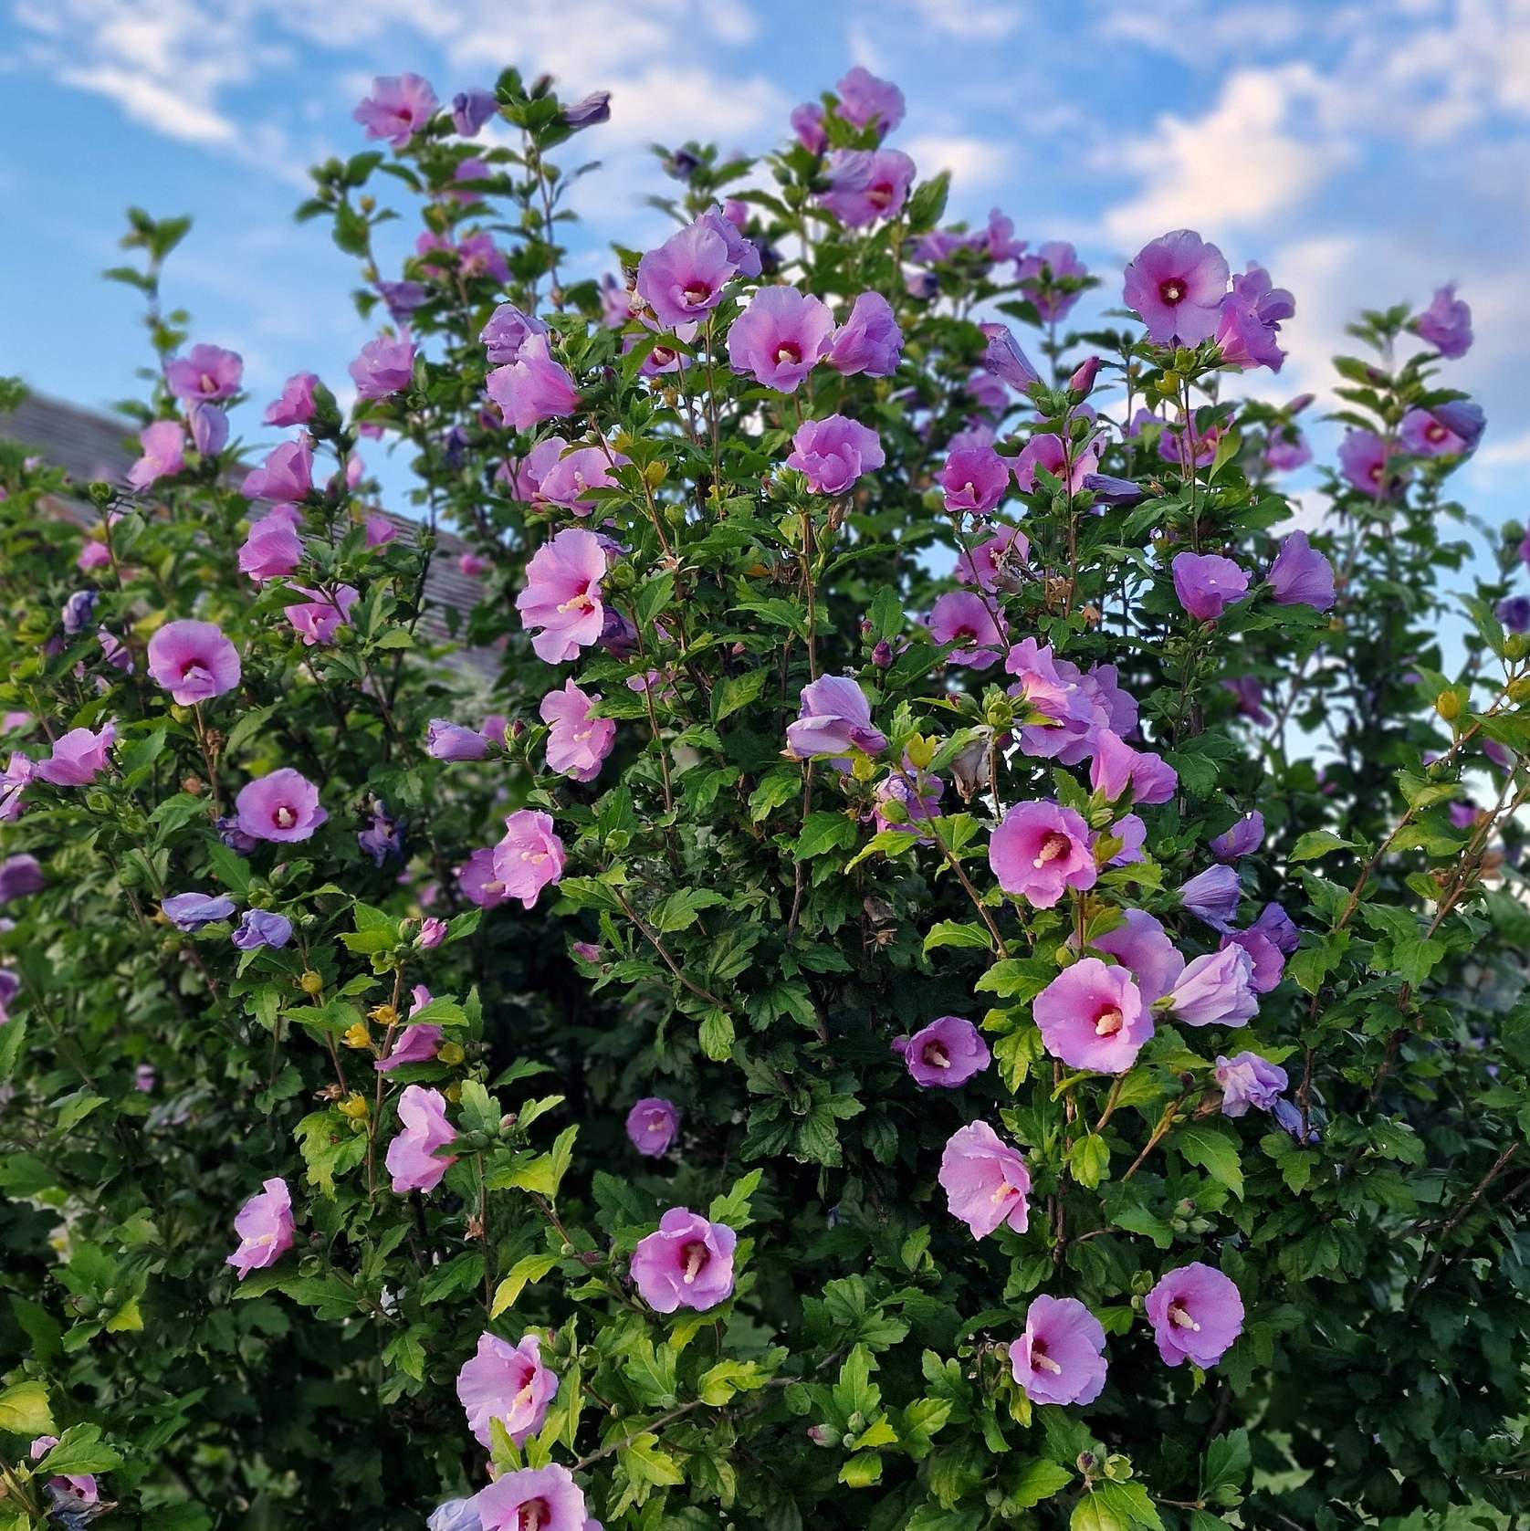
Rose of Sharon Hibiscus syriacus
Native: China and India
Zones: 5 to 8
Bloom: July to October
Color: Pinks, reds, whites, showy
Height: 5 to 8 ft.
Light: Full sun to part shade
Habit: Upright, vase-shaped
Water: Medium
Soil: Moist, rich
Fall: Remains green until leaves turn brown and falls

